Slide 1
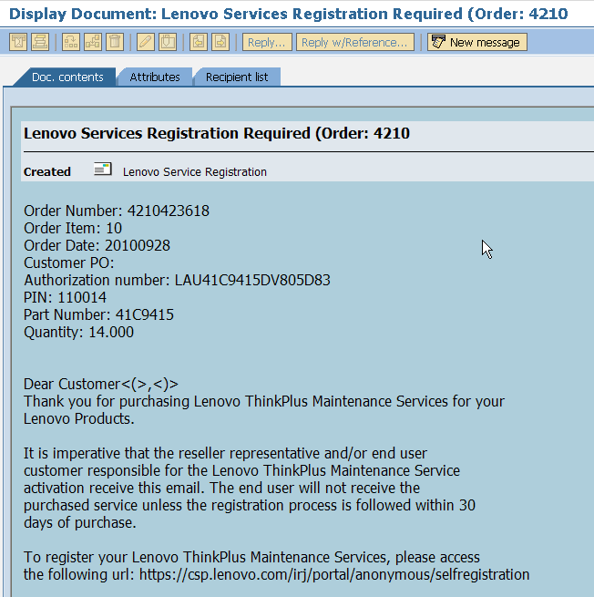
Service Registration Scenario 3 _ E-Pack

Slide 2
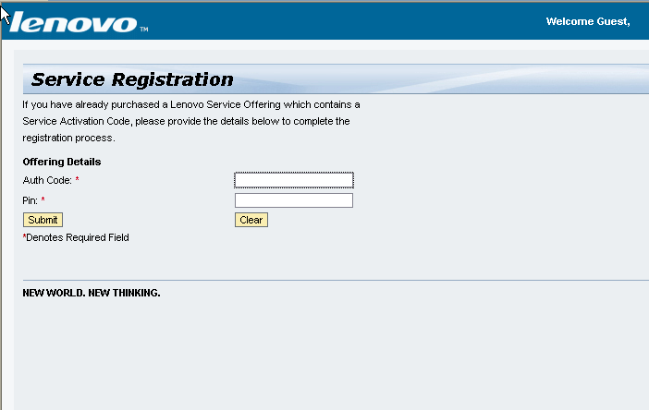
Service Registration Scenario 3 _ E-Pack
http://csp.lenovo.com/irj/portal/anonymous/selfregistration

Slide 3
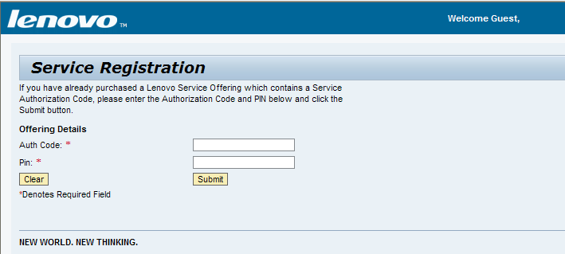
Service Registration Scenario 3 _ E-Pack
Enter Auth code/Pin user got in the registration mail

Slide 4
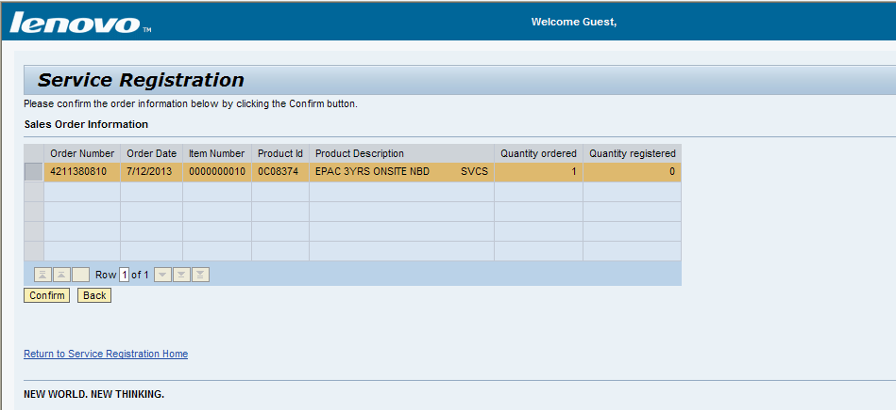
Service Registration Scenario 3 _ E-Pack

Slide 5
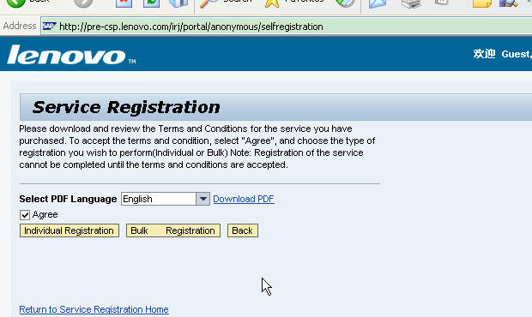
Service Registration Scenario 3 _ E-Pack
Notes:
. User click the confirm button, the system will show the T&C file to the user. There will be a default language version for the user but the user can also select the other language version from the dropdown list. The system will determine the country is hard copy or not.
If it is not a hard copy country, it will show the below page:

Slide 6
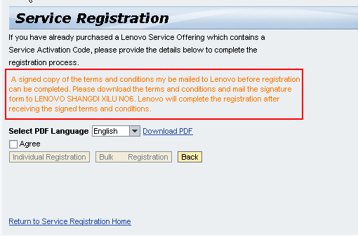
Service Registration Scenario 3 _ E-Pack
Notes:
If it is a hard copy country, it will show the below page. For the hard copy country, it will follow the normal process but the registration will not really finished. Until the user send the signed T&C to the Lenovo and Lenovo internal user approved the orders, the registration process and the BP create process will be finished really.

Slide 7
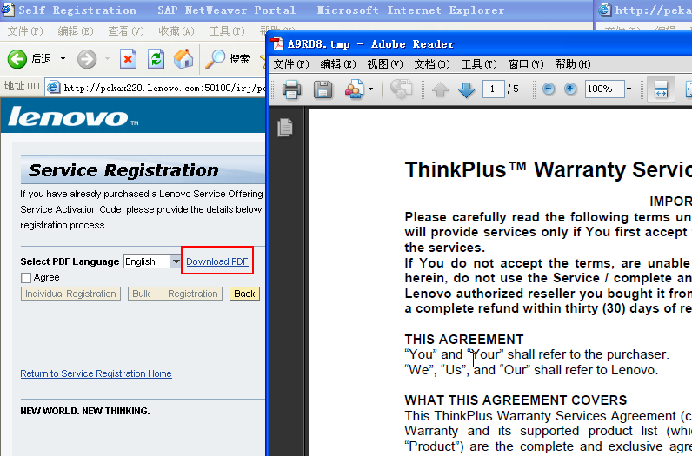
Service Registration Scenario 3 _ E-Pack
Notes:
ser select a language version and click the download PDF link, the system will show the file to the user. The user can also use the save and print function of the Adobe Reader Software.

Slide 8
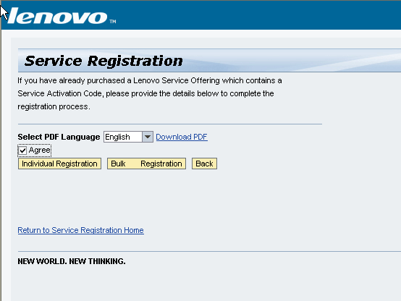
Service Registration Scenario 3 _ E-Pack
User can click the Individual Registration and Bulk Registration button to continue the process.
Notes:
User select the Agree value and the Individual Registration and Bulk Registration button will be available

Slide 9
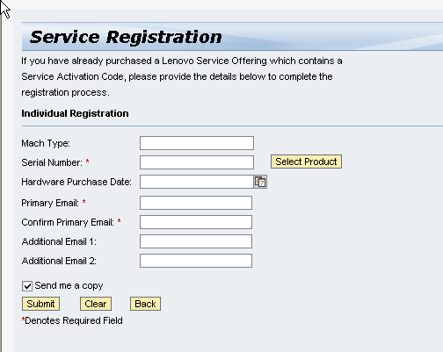
Service Registration Scenario 3 _ E-Pack
If the user click the Individual Registration button, the system will show the individual registration page

Slide 10
Service Registration Scenario 3 _ E-Pack
The user input the information fields and click the submit button
Field | comments
Mach type
Serial number | User can input the serial number and click the select product button to search for the mach type
Hardware purchase date | The system will use this date to update the warranty information of the iobject
Primary email | If the registration can be processed successfully, the system will send a email to this email
Confirm primary email | Just confirm. Need to the same with the primary email
Additional email 1 | Will receive a copy email
Additional email 2 | Will receive a copy email
Send me a copy | If the user select this value, the user will also receive a copy email

Slide 11
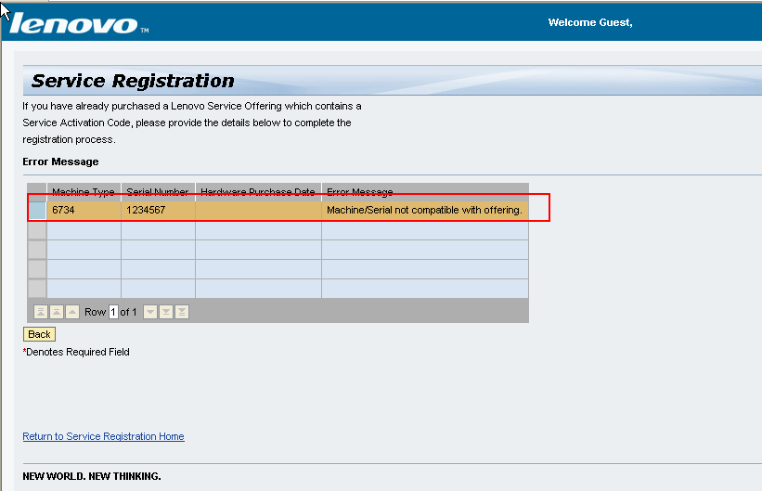
Service Registration Scenario 3 _ E-Pack
If the data has any problem ,our system will show the error message to the user.

Slide 12
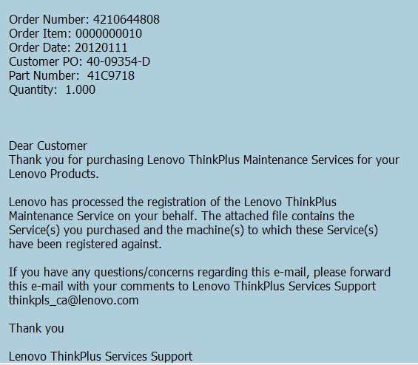
Service Registration Scenario 3 _ E-Pack
If the registration process can be finished successfully, the system will send a email to the user.

Slide 13
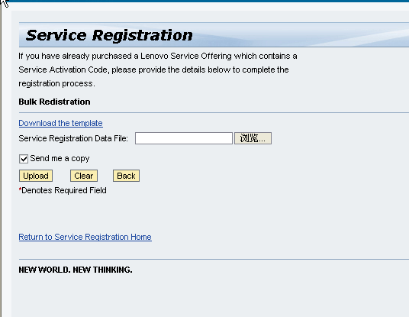
Service Registration Scenario 3 _ E-Pack
If the user click the Bulk Registration button, the system will show the bulk registration page

Slide 14
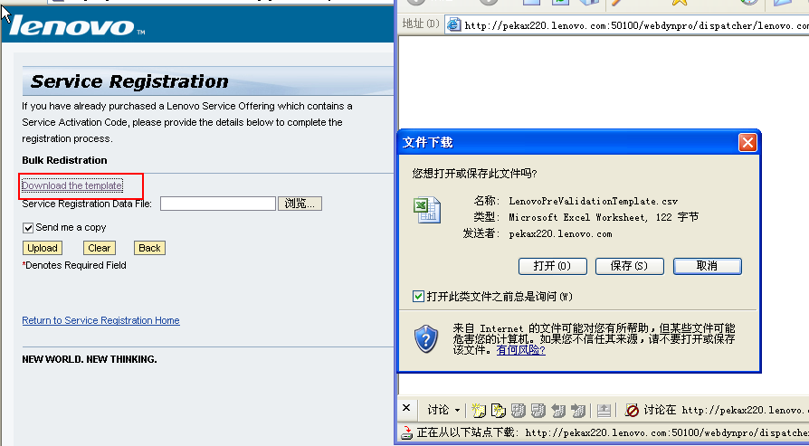
Service Registration Scenario 3 _ E-Pack
User click the Download the template link to download the bulk registration template

Slide 15
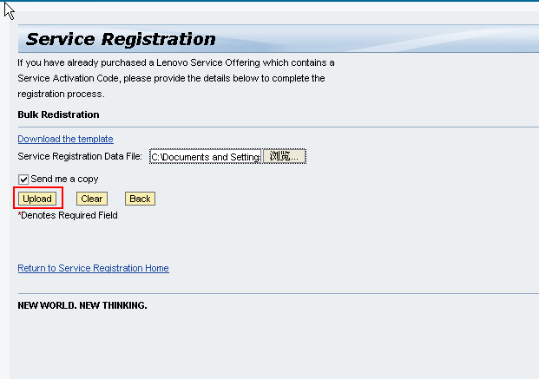
Service Registration Scenario 3 _ E-Pack
User input the machine information in the excel file and upload to the system. Then click the upload button.

Slide 16
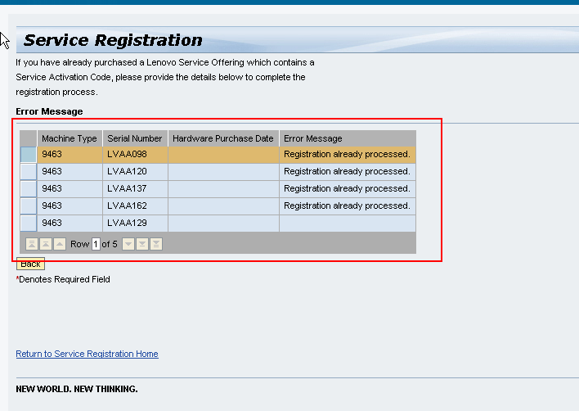
Service Registration Scenario 3 _ E-Pack
If the data has any problem ,our system will show the error message to the user

Slide 17
Service Registration Scenario 3 _ E-Pack
If the registration process can be finished successfully, the system will send a email to the user.

